Slide 1
Module 1: Telecommunications Fundamentals (Week 1)
Essential Basics for Non-Telecom Students

Slide 2
Learning Objectives
• Understand the basics of telecommunications
• Identify key components of communication systems
• Differentiate analog vs digital
• Recognize network topologies

Slide 3
Importance of Telecommunications
Telecommunications connects people, businesses, and devices worldwide. It drives innovation in healthcare, education, finance, and more.

Slide 4
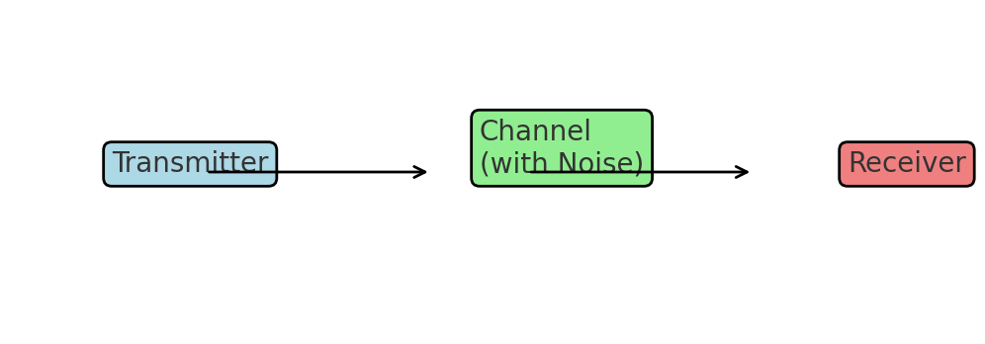
Communication System Overview

Slide 5
Applications of Telecommunications
• Education – e-learning platforms
• Healthcare – telemedicine
• Finance – online banking
• Social Media & Streaming

Slide 6
Evolution of Telecommunications
From telegraphs and telephones to 5G and IoT. Telecommunications has continuously evolved to improve connectivity and communication speed.

Slide 7
What is Telecommunications?
Telecommunications is the exchange of information over distances using electronic means.

Slide 8
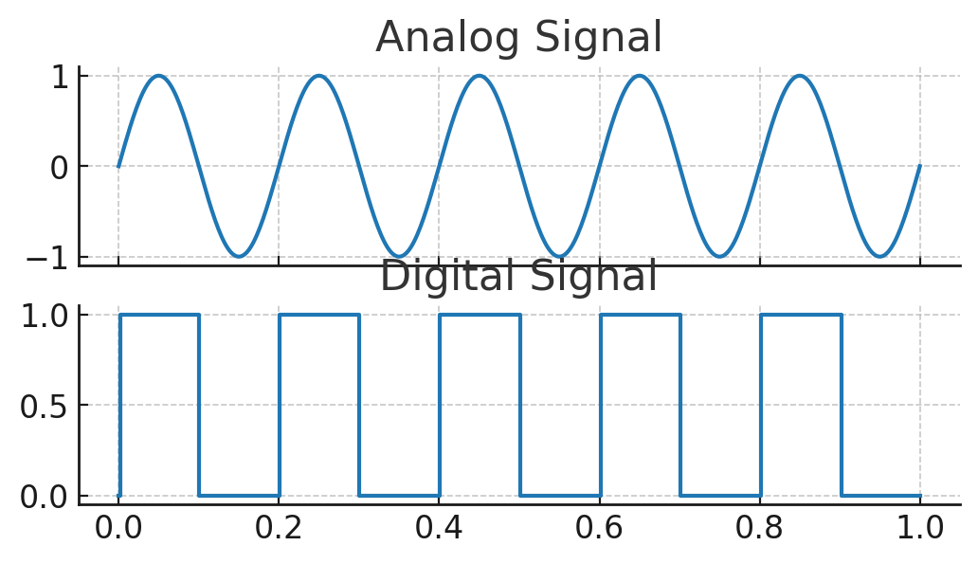
Analog vs Digital Signals

Slide 9
Scope of Telecom Systems
Includes wired and wireless networks, internet, satellites, broadcasting, and mobile communications.

Slide 10
Examples of Telecom Systems
• Telephone networks
• Internet
• Satellite systems
• Fiber optic systems

Slide 11
Telecom System Overview
Diagram: High-level flow of a telecommunications system (Transmitter → Channel → Receiver)

Slide 12
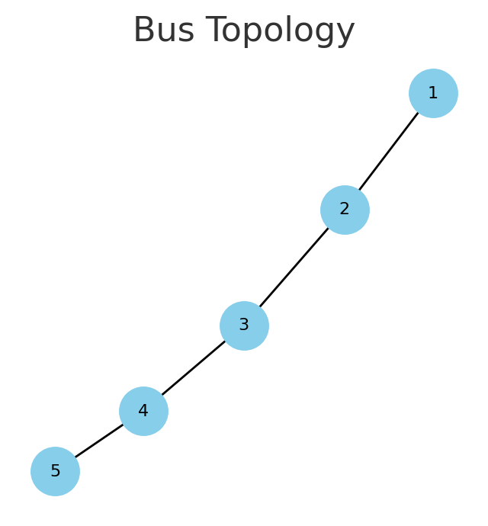
Bus Topology

Slide 13
Quick Quiz
Q: Which of these is NOT a telecom system?
A) Satellite
B) Internet
C) Microwave Oven
D) Mobile Phone

Slide 14
Introduction to Communication Systems
Communication systems consist of transmitter, channel, and receiver.

Slide 15
Transmitter
The device/system that sends signals. Example: Mobile phone microphone & circuitry.

Slide 16
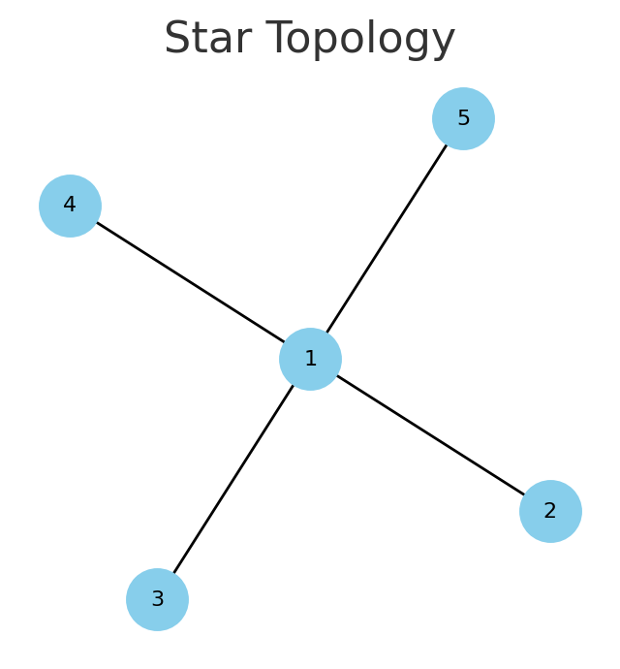
Star Topology

Slide 17
Transmitter Diagram
Diagram placeholder: Signal encoding & transmission process.

Slide 18
Channel
Medium carrying the signal. Types: Wired (fiber, copper) and Wireless (radio, satellite).

Slide 19
Noise & Interference
Unwanted signals that distort the transmitted message.

Slide 20
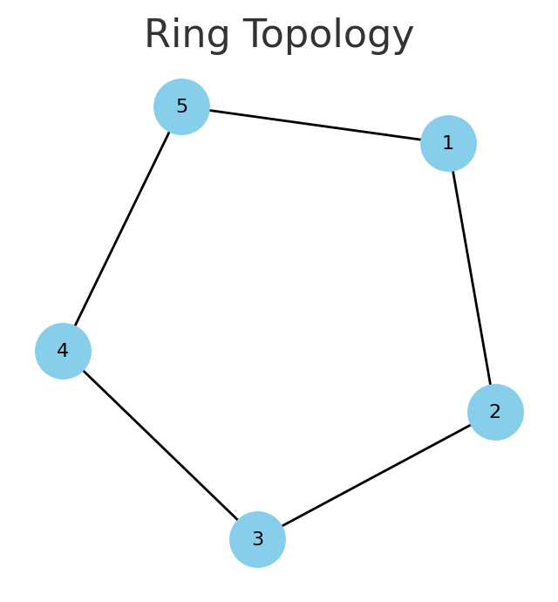
Ring Topology

Slide 21
Receiver
The device/system that receives and decodes signals. Example: Mobile phone speaker & circuitry.

Slide 22
Receiver Diagram
Diagram placeholder: Signal reception & decoding process.

Slide 23
Complete Communication System
Transmitter → Channel → Receiver (with noise).

Slide 24
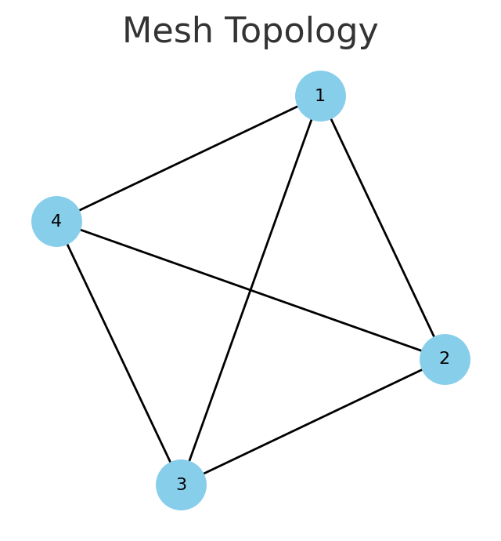
Mesh Topology

Slide 25
Real-Life Example
Example: Mobile phone call flow across network infrastructure.

Slide 26
Recap of Components
Transmitter, Channel, Receiver with noise & encoding/decoding.

Slide 27
Voice Communication
Transmission of spoken words over telecommunication systems (telephony, VoIP).

Slide 28
Data Communication
Exchange of digital data between devices (internet, email).

Slide 29
Video Communication
Transmission of moving images (video calls, streaming).

Slide 30
Multimedia Communication
Integration of voice, data, video (Zoom, WhatsApp).

Slide 31
Communication Types Comparison
Diagram placeholder: Voice vs Data vs Video vs Multimedia.

Slide 32
Real-life Applications
VoIP, Zoom, WhatsApp, Netflix, Online gaming.

Slide 33
Pros & Cons
Advantages: fast, versatile. Limitations: bandwidth, latency issues.

Slide 34
Knowledge Check
Q: Which type is Netflix streaming?
A) Voice
B) Data
C) Video
D) Multimedia

Slide 35
Analog vs Digital
Analog uses continuous signals, Digital uses discrete signals.

Slide 36
Analog Signal
Continuous wave varying over time. Example: FM Radio.

Slide 37
Analog Waveform
Diagram placeholder: Continuous sinusoidal wave.

Slide 38
Digital Signal
Discrete waveforms (0s and 1s). Example: Computer data.

Slide 39
Digital Waveform
Diagram placeholder: Square digital pulses.

Slide 40
Performance Metrics
SNR, Bandwidth, Latency, Throughput.

Slide 41
Comparison
Analog vs Digital: Noise sensitivity, efficiency, clarity.

Slide 42
Practical Example
Analog TV vs Digital Streaming.

Slide 43
System Architecture Overview
Communication system architectures define how devices are connected.

Slide 44
Network Topologies Intro
Topology defines network layout and connections.

Slide 45
Bus Topology
Diagram placeholder: Single backbone connection.
Pros: Simple
Cons: Failure affects all.

Slide 46
Star Topology
Diagram placeholder: Central node connects all.
Pros: Easy to manage
Cons: Hub failure.

Slide 47
Ring Topology
Diagram placeholder: Devices in a loop.
Pros: Predictable
Cons: Failure breaks loop.

Slide 48
Mesh Topology
Diagram placeholder: Every node connected.
Pros: Reliable
Cons: Expensive.

Slide 49
Hybrid Topology
Combination of topologies. Scalable, flexible.

Slide 50
Real-Life Example
Enterprise network combining star + mesh.

Slide 51
Summary
Recap of architectures and topologies.

Slide 52
Hands-On Activity
Use free tools like Draw.io or Lucidchart to create telecom diagrams.

Slide 53
Step 1
Draw a basic communication system: Transmitter → Channel → Receiver.

Slide 54
Step 2
Add noise and real-life devices to the diagram.

Slide 55
Step 3
Plot signals using Python matplotlib (Analog vs Digital).

Slide 56
Wrap-up
Present diagrams in class and discuss signal flow analysis.

